Slide 1

Impacts of Participatory Budgeting on Governance & Well-Being
Welcome! Here’s how to start our seminar:
Say hello in the chat! Share your name, organization name, location, and why you signed up for this webinar.
Choose your language. Click the Interpretation symbol. Select PT - Portuguese, ES - Spanish, FR - French, or Off for English. To hear the interpreted language only, click Mute Original Audio.
peoplepoweredhub.org @PeoplePowrd

Slide 2
Impacts of Participatory Budgeting on Governance & Well-Being
^{Online Seminar}

Slide 3
Goals
Better understand how PB can improve governance & well-being.
Identify key impacts of PB on governance and well-being based on leading research.
Identify specific practices & next steps for increasing the impacts of PB.

Slide 4
Agenda
Welcome & Introductions
How Participatory Budgeting Creates Change
Key Research Findings
Practical Implications
Next Steps
Q&A
You can ask questions in English, Spanish, French, or Portuguese in the Chat window!
We will come back to them during the Q&A section.

Slide 5

Welcome & Introductions

Slide 6





Speakers
Czarina Medina-Guce
Ateneo de Manila University
Manila, Philippines
Brian Wampler
Boise State University
Boise, United States
Michael Touchton
University of Miami
Miami, United States
Tarson Núñez
Laboratório de Políticas Públicas e Sociais (LAPPUS)
Porto Alegre, Brazil
Greta Ríos
Ollin
Mexico City, Mexico

Slide 7



Partners

Slide 8
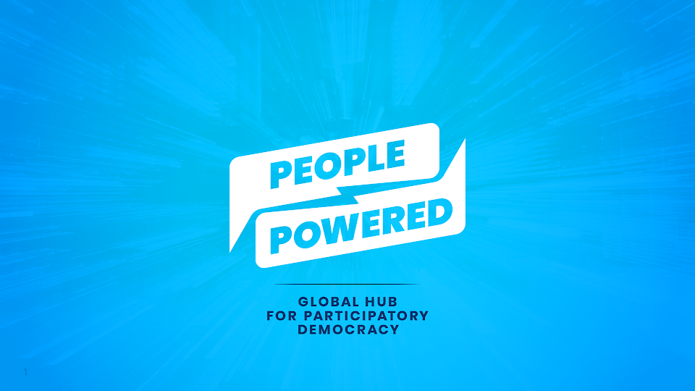

Slide 9
Our
Mission
Our mission is to expand people’s power to make government decisions, by supporting organizations
and governments that are building participatory
democracy around the world.

Slide 10



What We Do
Share Resources
Build Power
Change Policies

Slide 11
Warm Up Activity

Slide 12
What changes in governance and well-being would you expect from PB?
Share your answer in the chat!

Slide 13

How Participatory Budgeting Creates Change

Slide 14
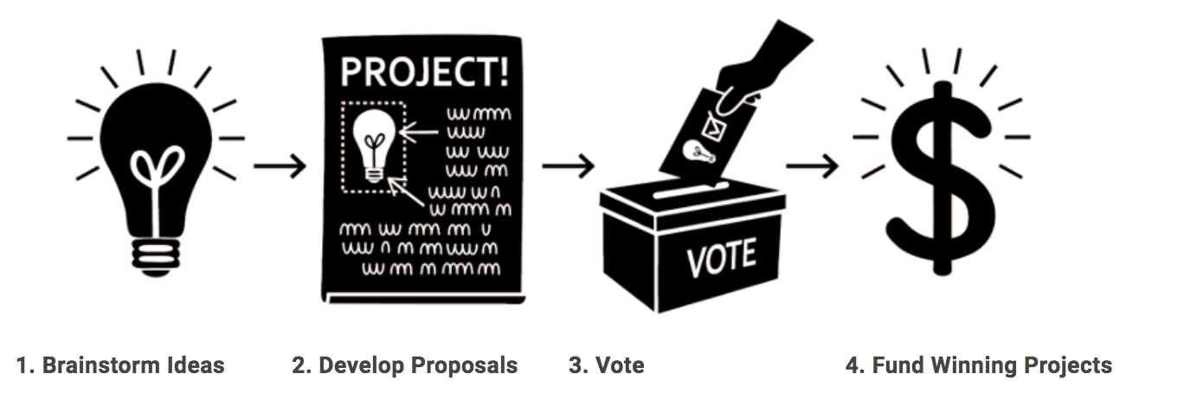
What is Participatory Budgeting?
Participatory budgeting (PB) is a democratic process in which community members decide how to spend part of a public budget.
Source: Participatory Budgeting Project

Slide 15
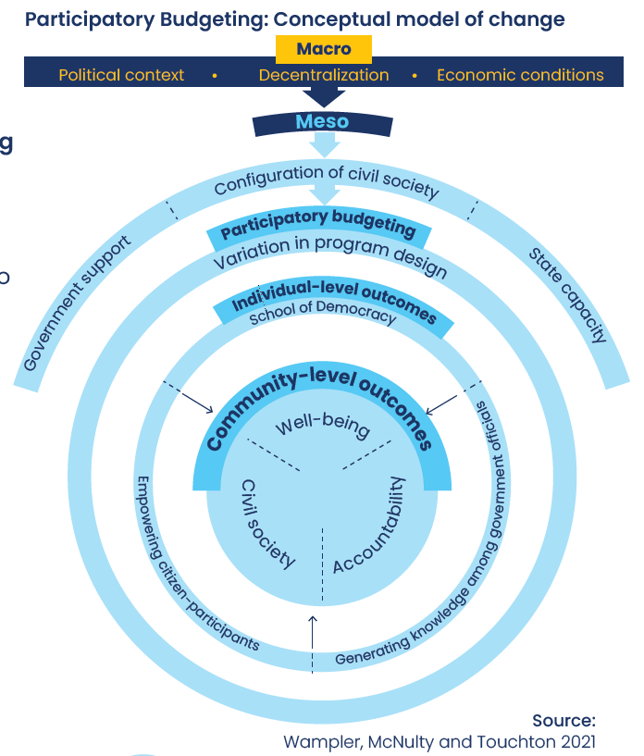
Theory of Change
for PB Impacts on Governance & Well-Being
We expect PB to alter how governments spend resources.
We expect PB to improve basic well-being when governments change how they allocate resources.

Slide 16
Setting Expectations
for PB Impacts
Impacts depend on the context and design of the PB process

Slide 17
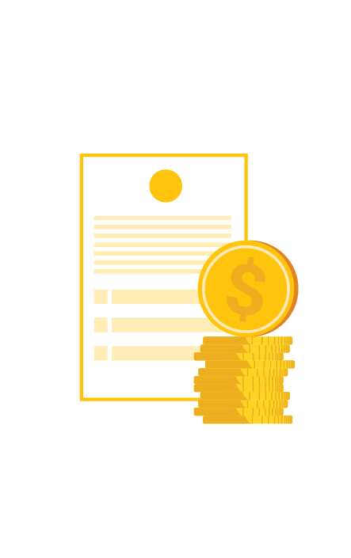
Research Questions & Indicators
Governance:
How does PB change the way governments operate and allocate resources, if at all?
Indicators:
government spending, tax revenues

Slide 18

Research Questions & Indicators
Well-Being:
How does PB improve individuals’ and communities’ quality of life, if at all?
Indicators:
Health (e.g., infant mortality, access to sanitation and water), Education (e.g., school enrollment), Public Safety (e.g., security cameras)

Slide 19

Key Findings
What We Know

Slide 20
Finding 1
PB programs tend to spend money differently.
New York City, United States:
  schools, public housing, streets
  parks, housing preservation, development
Porto Alegre, Brazil: water and sewage infrastructure
Brazil: health care, education

Slide 21
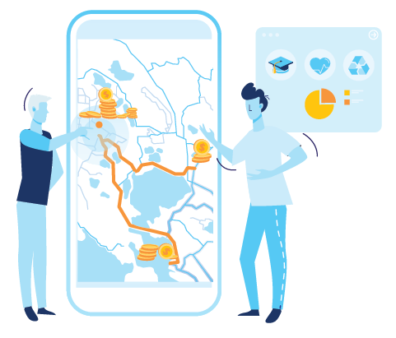
Finding 2
PB redirects spending to low-income communities, when it uses equity criteria.
Porto Alegre and Belo Horizonte, Brazil
New York City, United States
Seoul, South Korea

Slide 22
Finding 3
Municipalities using PB generate more local tax revenues.
In Brazil, there was a 30% increase in local taxes in municipalities using PB compared to comparable municipalities without PB.
Extra amounts collected are roughly the same as the amounts dedicated to PB.

Slide 23
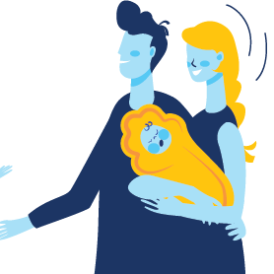
Finding 4
PB is associated with lower infant mortality.
Municipalities using PB programs in Brazil have lower infant mortality than comparable municipalities without PB. The effect grows stronger after 8+ years of PB.

Slide 24
Finding 5
PB with “social justice rules” is associated with lower infant mortality.
In Brazil, the adoption of social justice rules, such as redirecting more funding to regions with low score in the Quality of Life Index, has helped neighborhoods with higher poverty.
Increased funding motivates low-income residents to participate, allowing them to prioritize projects that meet their needs.
Social justice rules also reduce the ability of wealthier residents to disproportionately influence the PB process.

Slide 25
Finding 6
Building budget literacy among community leaders has a greater impact on well-being than educating all PB participants.
Municipalities with PB that build budget literacy and knowledge by holding informational workshops specifically for PB delegates and leaders are associated with lower infant mortality rates than municipalities that seek to educate all participants.

Slide 26

Finding 7
These impacts differ across locations, depending on local circumstances:
Government responsibilities
State capacity
Resources
Scope of PB projects

Slide 27
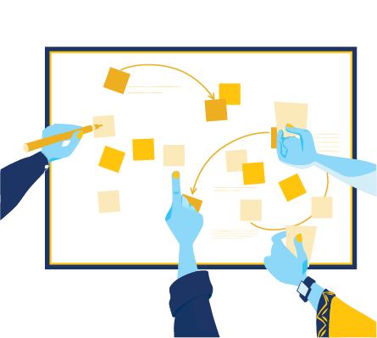
Practical Implications
What To Do

Slide 28
Planning & Design
Design rules to achieve the desired impacts
  Use equity criteria such as the score in the Quality of Life Index for selecting projects & distributing funds across districts.
  Include spending on health infrastructure and programs as eligible projects.
  Adopt social justice rules that explicitly redirect more resources to communities that need them the most.

Slide 29
Planning & Design
Work with community leaders to improve understanding & engagement in the process
  Target informational workshops to the most active community leaders, particularly budget delegates.
  Support budget delegates to educate their members and other community leaders.
  Partner with local universities to identify underserved neighborhoods.

Slide 30
Porto Alegre, Brazil
Two stages to prioritize projects:
Participants voted for priority themes (health, sanitation, pavement, etc.).
Participants voted for specific projects.
Voting doesn’t necessarily lead to socially just results.
Used technical criteria to divide money among 16 regions based on factors like population, poverty, and health needs. This shifted resources to lower income neighborhoods.
Area for improvement: Developing budget literacy.

Slide 31

Advocacy
Make a realistic but persuasive case to decision-makers
You need local buy-in to improve governance.
Expect different impacts in different places, depending on local economic and political factors.
PB can help to raise tax revenues, keeping in mind that the effect may not be immediate.

Slide 32
Advocacy
Mobilize residents, especially low-income residents, so that the new budget will align with their interests.

Slide 33
Research
Collect key data to measure impacts
  Use indicators that are easy to understand, comparable among different communities, and traceable through time.
  Use georeferenced data to track which neighborhoods PB funding goes to.

Slide 34

Research
Involve the community in monitoring and evaluation of PB-funded project implementation
Investigate how PB impacts well-being in contexts where local governments have little influence over certain policies or little capacity, or where the scope of PB projects is limited.

Slide 35
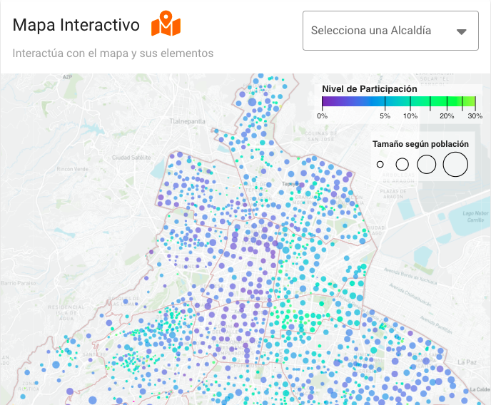
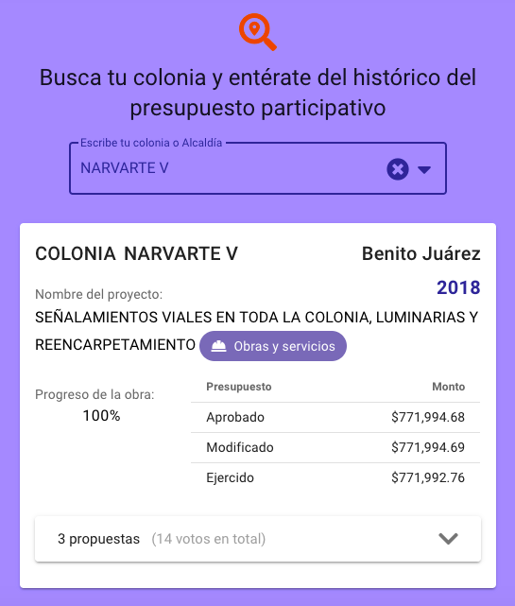
Mexico City, Mexico

Slide 36
Next Steps

Slide 37
Key Findings & Recommendations
Key Findings:
PB programs tend to spend money differently
PB redirects funding to low-income communities when using equity criteria
PB can generate more local tax revenues
PB is associated with lower infant mortality

Slide 38
Key Findings & Recommendations
Key Findings:
PB with “social justice rules” is associated with lower infant mortality
Building budget literacy among community leaders has a greater impact on well-being than educating all PB participants
Impacts differ across locations

Slide 39

Key Findings & Recommendations
Key Recommendations:
Make a realistic but persuasive case to decision-makers
Design rules to achieve the desired impacts
Work with community leaders to improve understanding & engagement in the process
Collect key data to measure impacts

Slide 40
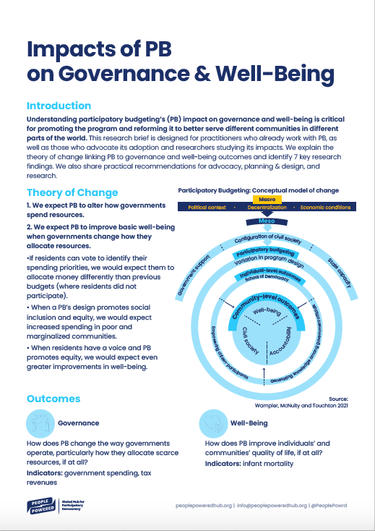
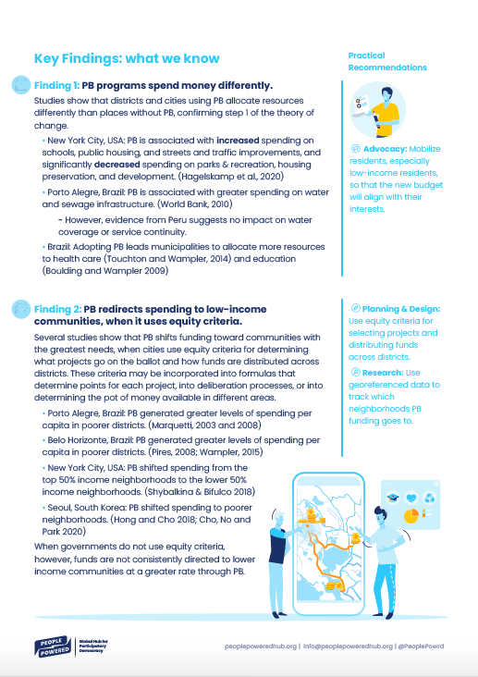
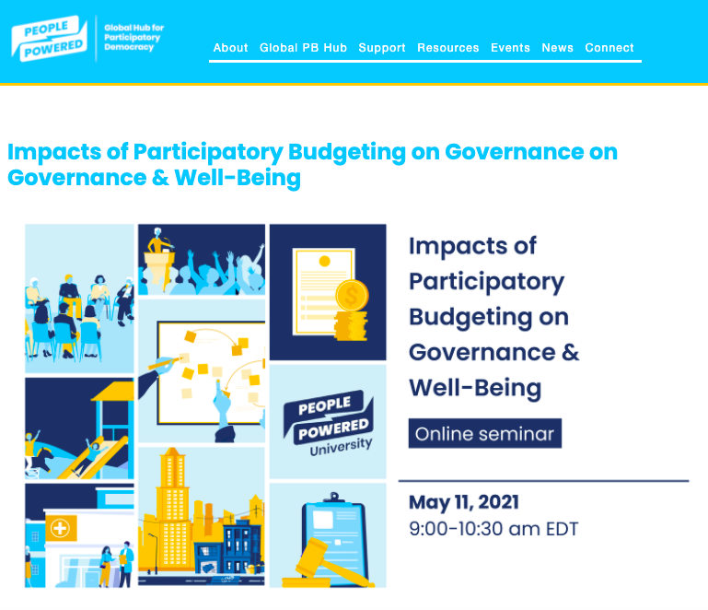
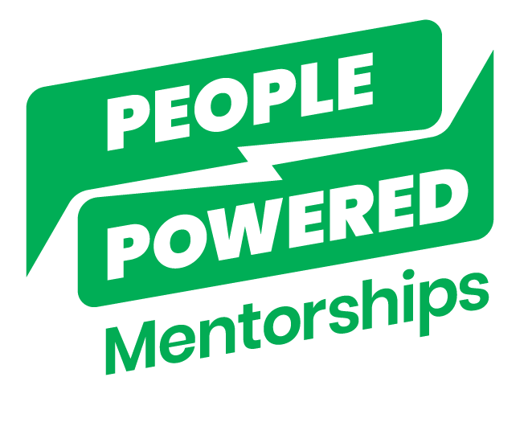
Research Brief & Support
www.peoplepoweredhub.org/pb-impacts-on-governance

Slide 41
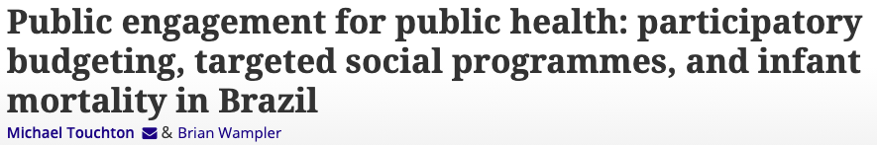
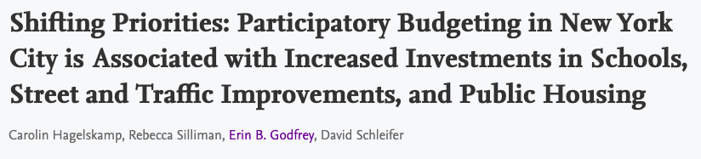
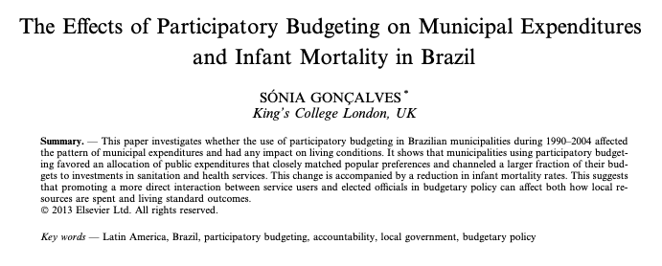
Additional Resources
www.peoplepoweredhub.org/pb-impacts-on-governance

Slide 42
Next Steps
Read the research brief and other recommended resources to learn more.
Use the research findings to advocate for PB.
Use the research findings to improve a PB process.
Provide funding or support for organizations working to advocate for and implement PB.
Conduct or support research on the identified research needs.
Sign up for People Powered’s mentorship program.
Share this seminar with other people and encourage them to take action.

Slide 43
Activity: Next Steps!
Respond to the questions that will appear on your screen!!

Slide 44

Announcements

Slide 45
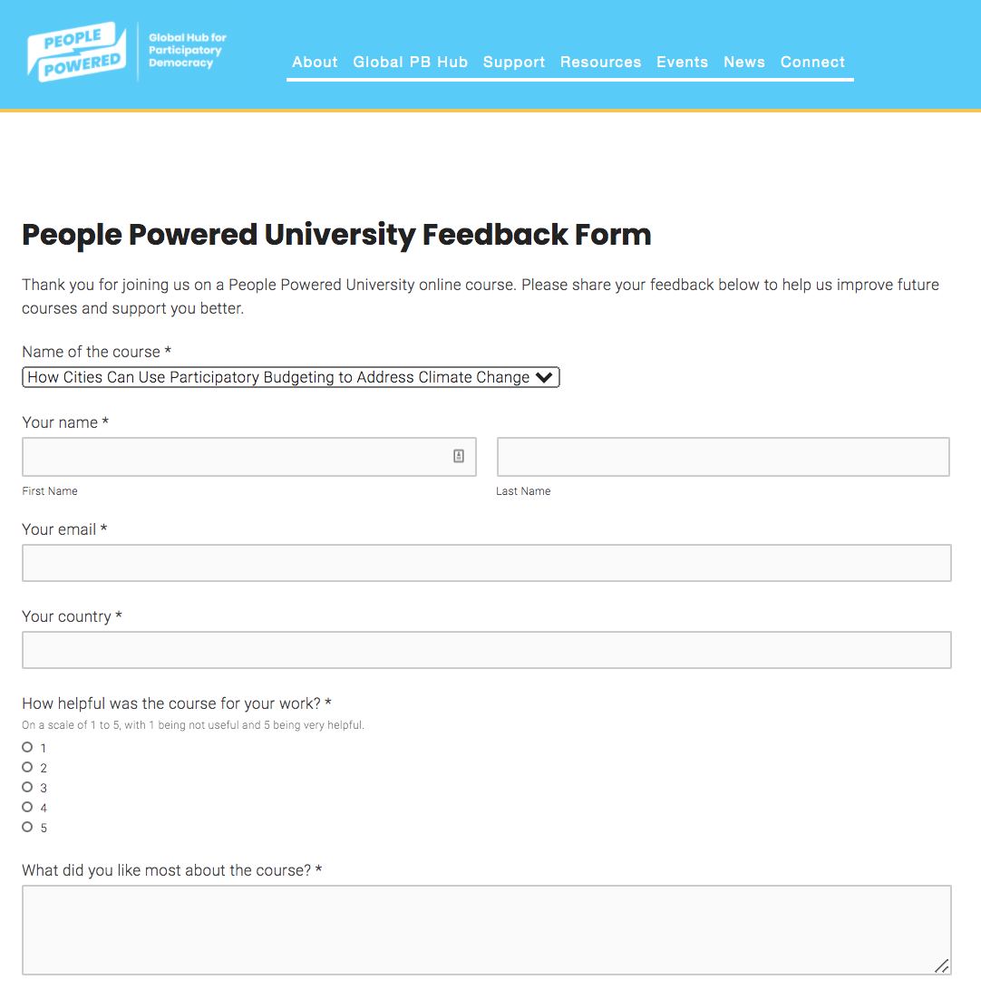
Evaluation form
www.peoplepoweredhub.org/ppu-feedback-form

Slide 46

Next PPU seminar and other opportunities
Next seminar: Impacts of
PB on Civil Society & Political Participation
peoplepoweredhub.org/mentorship

Slide 47
Q&A

Slide 48
Key Takeaways
Type the main thing that you learned today,
in the chat

Slide 49
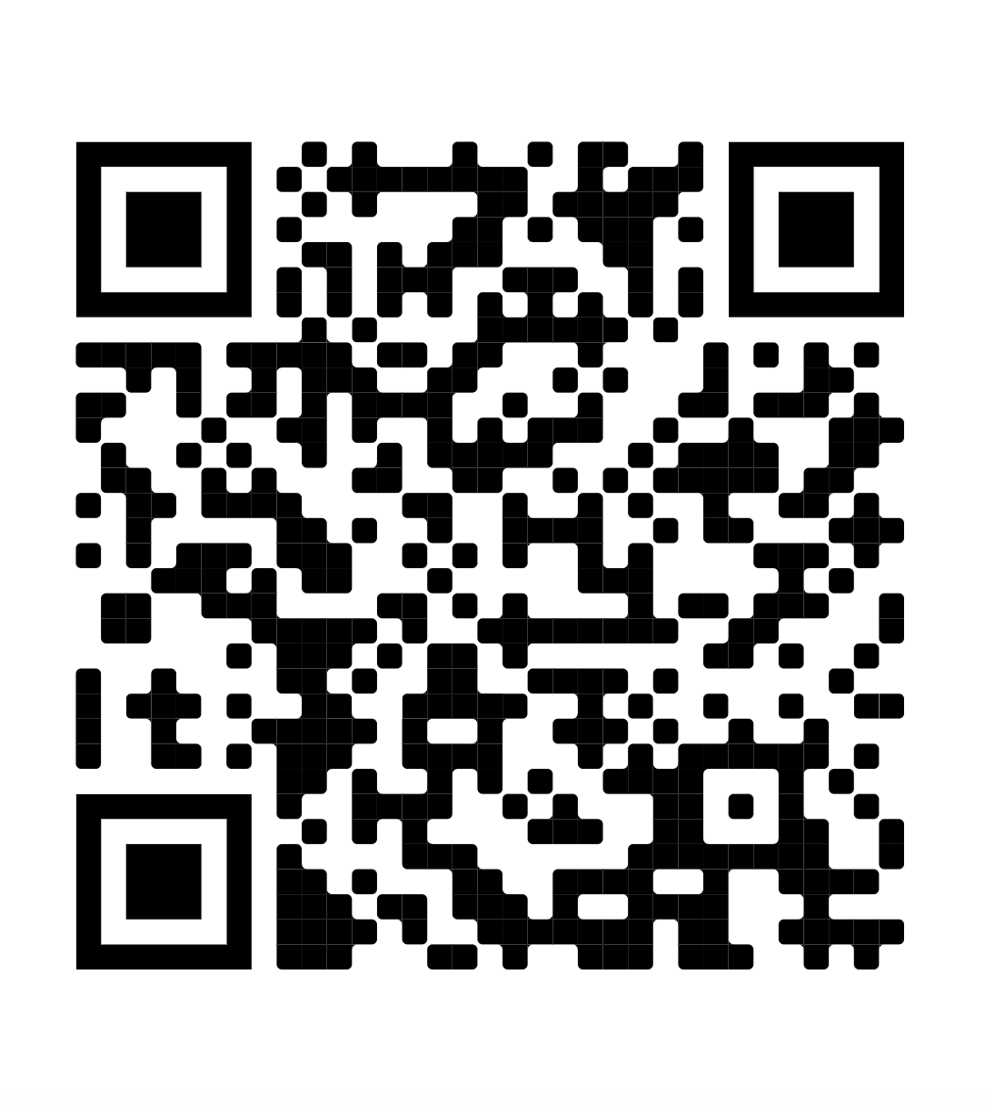
Research Brief & Support
www.peoplepoweredhub.org/pb-impacts-on-governance

Slide 50
Next PPU seminar and other opportunities
Next seminar: Impacts of
PB on Civil Society & Political Participation
peoplepoweredhub.org/mentorship

Slide 51
Evaluation form
www.peoplepoweredhub.org/ppu-feedback-form

Slide 52
Thank you!!

Slide 53
Thank you!!
Web: www.peoplepoweredhub.org
Email: info@peoplepoweredhub.org
Twitter: @PeoplePowrd
Facebook: /PeoplePoweredHub
LinkedIn: /PeoplePowered

